Slide 1


Slide 2
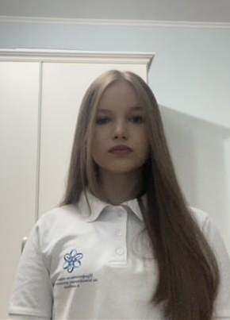
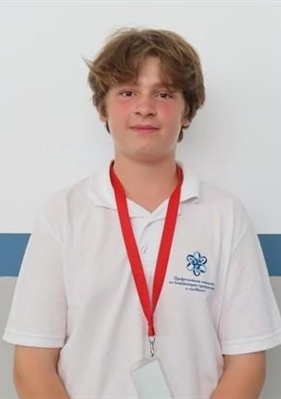
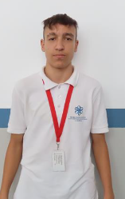
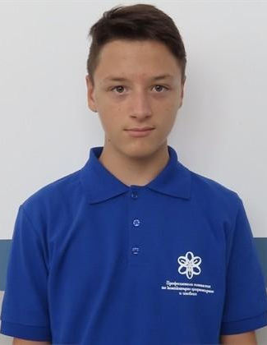
Our Team
Mila Lazarova
Designer
Borimir Kirov
Scrum-trainer
Alexander Georgiev
Back-end developer
Dimitar Dimitrov
Back-end developer

Slide 3
Stages of creation
01
03
02
04
Create team
Make an application
Choose an idea
Make documentation

Slide 4







FIRST ANNOUNCEMENT

Slide 5
Let’s get to the application

